Slide 1


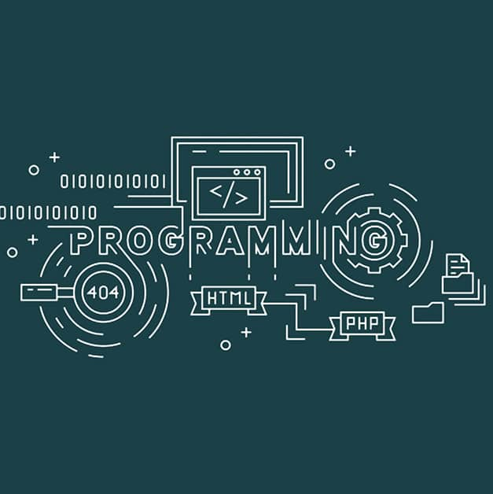


Programming and Problem Solving in C

Slide 2
Classroom Etiquette and Guidelines:
Let me know if the pace of the class is too fast.
Feel free to ask questions if you have any doubts.
Try to Answer the Question
Always arrive on time.
Do not talk while the class is in session.
Avoid eating during the class.

Slide 3
What is Programming?
What is Programming Language?

Slide 4
What is Programming? : Writing a Program
What is Programming Language? : Is a Collection of Tokens.

Slide 5
Module-1: BASICS OF C PROGRAMMING :
Introduction to programming paradigms: Applications of C Language, Structure of C program
C programming: Data Types, Constants, Enumeration Constants, Keywords.
Operators: Precedence and Associativity, Expressions, Input/Output statements, Assignment statements, Decision making statements, Switch statement, Looping statements Preprocessor directives, Compilation process.

Slide 6
Module-2: ARRAYS AND STRINGS :
Introduction to Arrays: Declaration, Initialization One dimensional array Two dimensional arrays.
String operations: length, compare, concatenate, copy, Selection sort, linear and binary search.

Slide 7
Module-3: FUNCTIONS AND POINTERS :
Modular programming : Function prototype, function definition, function call, Built-in functions (string functions, math functions) Recursion, Binary Search using recursive functions.
Pointers: Pointer operators, Pointer arithmetic, Arrays and pointers, Array of pointers.
Parameter passing: Pass by value, Pass by reference.

Slide 8
Module-4: STRUCTURES AND UNION :
Structure: Nested structures, Pointer and Structures, Array of structures, Self referential structures
Dynamic memory allocation: Singly linked list, typedef
Union: Storage classes and Visibility.
Module-5: FILE PROCESSING :
Files Types of file processing: Sequential access, Random access Sequential access file - Random access file - Command line arguments.

Slide 9
Experiments or Lab Programs:
Simulation of a Simple Calculator.
Implement Binary Search on Integers
Sort the given set of N numbers using Bubble sort.
Implement Matrix multiplication and validate the rules of multiplication.
An electricity board charges the following rates for the use of electricity: for the first 200 units 80 paise per unit: for the next 100 units 90 paise per unit: beyond 300 units Rs 1 per unit. All users are charged a minimum of Rs. 100 as meter charge. If the total amount is more than Rs 400, then an additional charge of 15% of total amount is charged. Write a program to read the name of the user, number of units consumed and print out the charges.
Write functions to implement string operations such as compare, concatenate, and find string length. Use the parameter passing techniques.
Implement structures to read, write and compute average- marks of the students, list the students scoring above and below the average marks for a class of N students.
Write a C program to copy a text file to another, read both the input file name and target file name.

Slide 10
Course Learning objectives:
1. Implement the constructs of C Language:
This objective focuses on understanding the basic syntax and constructs of C language such as variables, data types, operators, control statements (like if, else, for, while), and expressions.
2. Construct C Programs using basic programming constructs:
This involves using loops, conditional statements, and basic input/output to solve problems.
3. Develop C programs using arrays and strings:
Arrays and strings allow storing and manipulating collections of data.
4. Organize modular applications in C using functions:
Functions improve modularity and code reusability.
5. Integrate pointers and structures in C applications and Execute input/output and file handling in C:
Pointers allow direct memory access, while structures help group related data. File handling enables storing and retrieving data.

Slide 11
Course outcome (Course Skill Set):
At the end of the course the student should be able to :
Sl. No. | Description | Bloom's Level
CO1 | Demonstrate knowledge on C Programming constructs | L5
CO2 | Develop simple applications in C using basic constructs | L4
CO3 | Design and implement applications using arrays and strings | L5
CO4 | Develop and implement modular applications in C using functions | L4
CO5 | Develop applications in C using structures and pointers | L4

